Slide 1
COMPUTER ORGANIZATION
B.TECH III SEM
CSE-4
N SANTOSHI
ASSISTANT PROFESSOR
DEPARTMENT OF ECE

Slide 2
INTRODUCTION
Definition of a computer: A computer can be defined as a fast electronic calculating machine that accepts the (data) digitized input information process it as per the list of internally stored instructions and produces the resulting information.
List of instructions are called programs & internal storage is called computer memory.

Slide 3
The different types of computers are
Personal computers
Note book computers
Work stations
Enterprise systems
Super computers

Slide 4
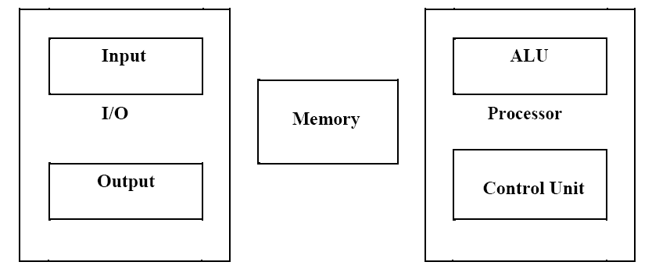
Functional units
A computer consists of five functionally independent main parts: input, memory, arithmetic logic unit (ALU), output and control unit.

Slide 5
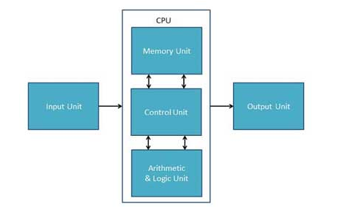

Slide 6
Central processing unit
CPU is considered as the brain of the computer.
CPU has following three components.
ALU(Arithmetic Logic Unit)
Control Unit
Memory or Storage Unit

Slide 7
Arithmetic logic unit (ALU)
Most of the computer operators are executed in ALU of the processor like addition, subtraction, division, multiplication, comparing etc.
The operands are brought into the ALU from memory and stored in high speed storage elements called register.

Slide 8
Control Unit
This unit controls the operations of all parts of the computer but does not carry out any actual data processing operations.
This unit controls the operations of all parts of the computer but does not carry out any actual data processing operations.

Slide 9
Memory unit
Its function is to store programs and data. It is basically of two types
Primary memory
Secondary memory
Primary memory is computer memory that is accessed directly by the CPU.
This includes several types of memory, such as the processor cache and ROM,RAM.

Slide 10
Memory in which any location can be reached in a short and fixed amount of time after specifying its address is called random-access memory (RAM)
The time required to access one word is called memory access time.
Memory which is only readable by the user and contents of which can’t be altered is called read only memory (ROM). It contains operating system

Slide 11
Secondary memory
It is used where large amount of data & programs have to be stored, particularly information that is accessed infrequently.
Examples: - Magnetic disks & tapes, optical disks (ie CD-ROM’s), floppies etc.,

Slide 12

Input units
Joysticks
Trackballs
mouse
scanners etc are other input devices

Slide 13

Output units
sends the processed results to the outside world
Examples:- Printer, speakers, monitor etc.
.

Slide 14
INTRODUCTION
ORGANIZATION AND ARCHITECTURE
Computer Architecture refers to those attributes of a system that have a direct impact on the logical execution of a program.
Examples:
the instruction set
the number of bits used to represent various data types
I/O mechanisms
memory addressing techniques
Reference: W. Stallings

Slide 15
Computer Organization refers to the operational units and their interconnections that realize the architectural specifications.
Examples are things that are transparent to the programmer:
control signals
interfaces between computer and peripherals
the memory technology being used
Reference: W. Stallings

Slide 16
Structure and Function
Structure is the way in which components relate to each other
Function is the operation of individual components as part of the structure
Reference: W. Stallings

Slide 17
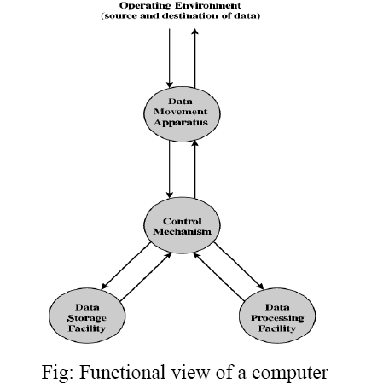
Function

Slide 18
All computer functions are
Data processing: Computer must be able to process data which may take a wide variety of forms and the range of processing.
Data storage: Computer stores data either temporarily or permanently.
Data movement: Computer must be able to move data between itself and the outside world.
Control: There must be a control of the above three functions.
Reference: W. Stallings

Slide 19
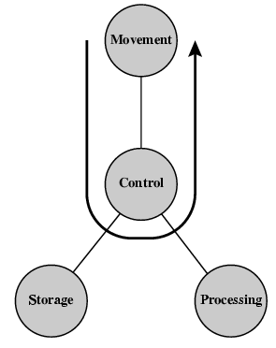
Data movement operation

Slide 20
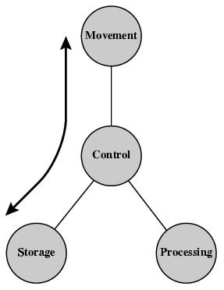
Storage operation

Slide 21
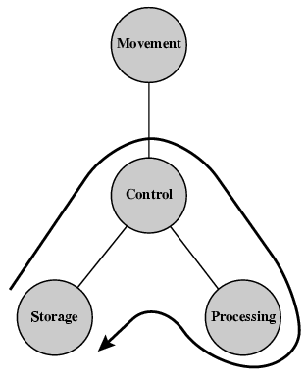
Processing from / to storage

Slide 22
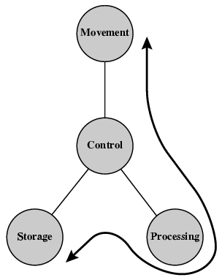
Processing from storage to i/o

Slide 23
System bus
Data bus- It defines the bit length of the processor.eg: 8bit processor have 8 bit data bus.
Address bus- It defines the max memory capacity of the processor.eg:8bit address means memory capacity=2^8=256 bytes
Control bus- The physical connections that carry control information between the CPU and other devices within the computer

Slide 24
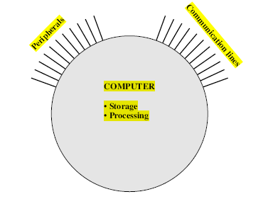
Structure
Structure is the way in which components relate to each other.

Slide 25
Four main structural components:
Central processing unit (CPU)
Main memory
I / O
System interconnections

Slide 26
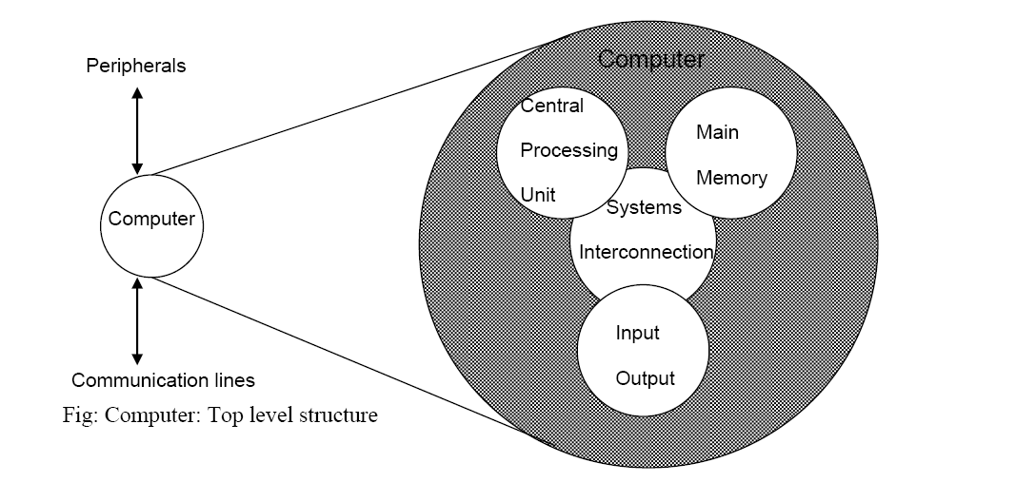

Slide 27
CPU structural components:
Control unit
Arithmetic and logic unit (ALU)
Registers
CPU interconnections

Slide 28
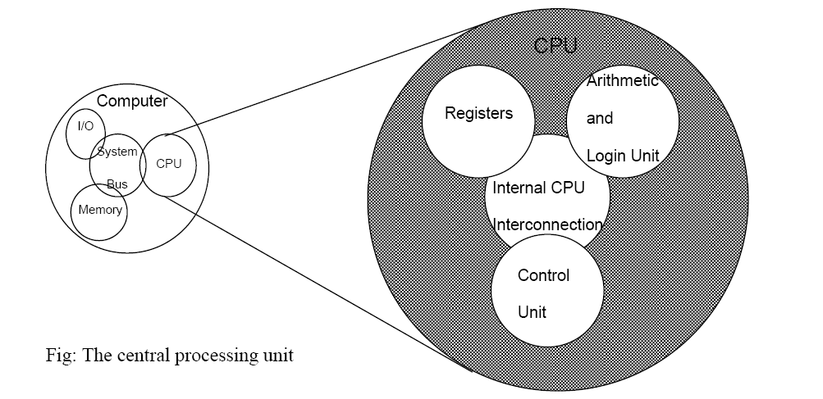

Slide 29
Control unit structural components:
Sequencing logic
Control unit registers and decoders
Control memory

Slide 30
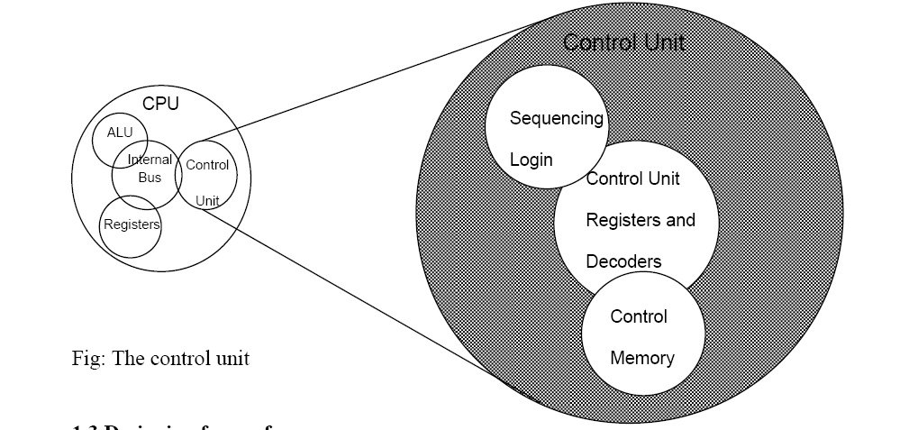

Slide 31
Input output subsystems
I/O subsystems controls all I/O devices.
The I/O subsystems provide the mechanism for communication between the CPU and the outside world(I/O devices).
Basic functions include:
Issuing commands to the devices.
Handling interrupts from devices.
Responding errors from devices.

Slide 32
Computer Components
The Control Unit (CU) and the Arithmetic and Logic Unit (ALU) constitute the Central Processing Unit (CPU)
Data and instructions need to get into the system and results need to get out
Input/output (I/O module)
Temporary storage of code and results is needed
Main memory (RAM)

Slide 33
What is a Register?
A register is a very small amount of very fast memory that is built into the CPU (central processing unit).
Contents can be accessed at extremely high speeds.
Registers are used to store data temporarily during the execution of a program.
Different processors have different register sizes.
Registers are normally measured by the number of bits they can hold, for example, an 8-bit register means it can store 8 bits of data or a 32-bit register means it can store 32 bit of data

Slide 34
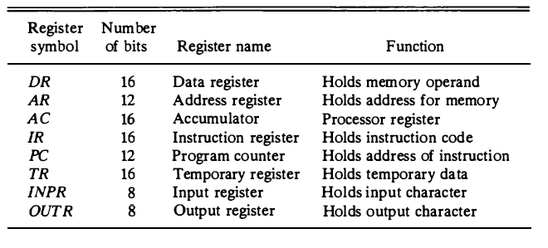
List of Registers for the Basic Computer
Reference: morris mano

Slide 35
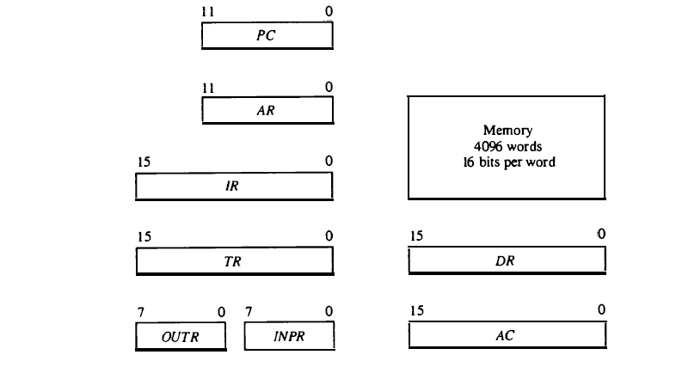
Basic computer registers and memory

Slide 36
Computer registers
ACCUMULATOR (AC): The processor register AC consists of 16-bits. It is used to hold the results or partial results of arithmetic and logical operations. An accumulator is a register in which intermediate arithmetic and logic results are stored.
DATA REGISTER (DR): The register DR consists of 16-bits and it is used to hold memory operands (data). This register contains the data to be written into memory or receives the data read from memory.

Slide 37
Computer registers
TEMPORARY REGISTER (TR): Temporary register have 16-bits and it provides temporary storage of variables or results.
INSTRUCTION REGISTER (IR): The instruction register consists of 16-bits. The purpose of the instruction register is to hold a copy of the instruction which the processor is to execute. In our basic computer, instruction register (IR) holds instruction code which is read from memory.

Slide 38
Computer registers
ADDRESS REGISTER (AR): This register specifies the address in memory for next read or writes operations. The address register consists of 12-bits.
PROGRAM COUNTER (PC): Program counter has 12-bits and it holds the address of the next instruction to be read from memory after the current execution is executed. The instructions are read sequentially because the program counter automatically increments after fetching the current instruction.

Slide 39
Computer registers
INPUT REGISTER (INPR): Input register has 8-bits. INPR register receives a character from an input device and delivers it to the AC.
OUTPUT REGISTER (OUTR): Output register has 8-bits. The output register receives information from AC and transfer it to the output device.

Slide 40
example
ADD AC,DR
AC=AC+DR
This instruction adds the contents of AC and DR stores the result in Accumulator.
AC=1234H
DR=2222H
After execution AC=3456H

Slide 41
Instruction
A Computer Instruction is a binary code that That specify a sequence of micro-operations for the computer.
Micro-operations are detailed low-level instructions used in some designs to implement complex machine instructions.

Slide 42
Instruction Set
An Instruction set is a group of bits that instruct computer to perform a specific operation.
The basic computer has three instructions code formats, each of 16 bit.

Slide 43
Types of Instructions
These are of three types:
Memory-Reference instruction
Register-Reference instruction
Input-Output instruction

Slide 44
Memory-Reference instruction
An instruction that has one or more of its operand addresses referring to a location in memory, as opposed to one of the CPU registers or some other way of specifying an operand.

Slide 45
Register-Reference instruction
A register-reference instruction specifies an operation on or a test of the AC register.
An operand from memory is not needed; therefore, the other 12 bits are used to specify the operation or test to be executed.

Slide 46
Input-Output instruction
An input-output instruction does not need a reference to memory and is recognized by the operation code Ill with a 1 in the leftmost bit of the instruction.
The remaining 12 bits are used to specify the type of input-output operation or test performed.

Slide 47
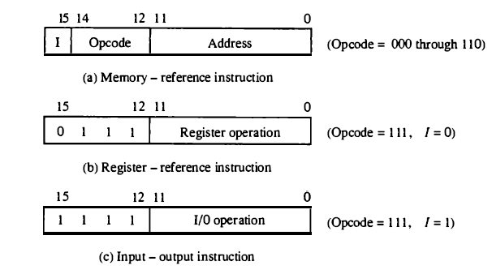
Various Instructions format
Reference: Morris mano

Slide 48
Instruction Cycle
The time period during which one instruction is fetched from memory and execute when a computer gives an instruction in machine language.
Each instruction cycle in turn is subdivided into a sequence of subcycles or phases.
After the execution the program counter is incremented to point to the next instruction.

Slide 49
Phases of Instruction Cycle
Fetch the instruction
Decode the instruction
Read the effective address from memory if the instruction has an indirect address.
Execute the instruction

Slide 50

The program counter PC is loaded with the address of the first instruction in the program
The sequence counter SC is cleared to 0, providing a decoded timing signal To.
After each clock pulse, SC is incremented by one, so that the timing signals go through a sequence T0, T1, T2, and so on.
The micro operations for the fetch and decode phases can be specified by the following register transfer statements.

Slide 51
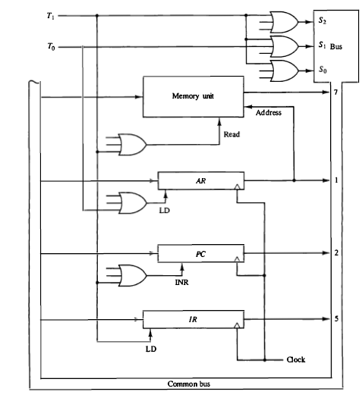
Register Transfer for Fetch phase

Slide 52
AR is connected to the address inputs of memory, it is necessary to transfer the address from PC to AR during the clock transition associated with timing signal T0
The instruction read from memory is then placed in the instruction register IR with the clock transition associated with timing signal T1•

Slide 53
At the same time, PC is incremented by one to prepare it for the address of the next instruction in the program.
At time T2, the operation code in IR is decoded, the indirect bit is transferred to flip-flop I, and the address part of the instruction is transferred to AR .
Note: SC is incremented after each clock pulse to produce the sequence To, T1, and T2•

Slide 54
To implement the first register transfer statement
To provide the data path for the transfer of PC to AR we must apply timing signal T0 to achieve the following connection:
Place the content of PC onto the bus by making the bus selection inputs S₂S₁S₀ equal to 010.
Transfer the content of the bus to AR by enabling the LD input of AR .

Slide 55

To implement the second register transfer statement
It is necessary to use timing signal T₁ to provide the following connections in the bus system.
Enable the read input of memory.
Place the content of memory onto the bus by making S₂S₁S₀ = Ill.
Transfer the content o f the bus t o IR b y enabling the LD input of IR .
Increment PC by enabling the INR input of PC .

Slide 56
Determining type of instruction
The timing signal that is active after the decoding is T3.
During time T3 the control unit determines the type of instruction that was just read from memory.
Decoder output D, is equal to 1 if the operation code is equal to binary Ill.
we determine that if D7 = I, the instruction must be a register-reference or input-output type.

Slide 57
If D, = 0, the operation code must be one of the other seven values 000 through 110, specifying a memory-reference instruction.
If D7 = 0 and I = 1, we have a memoryreference instruction with an indirect address.

Slide 58
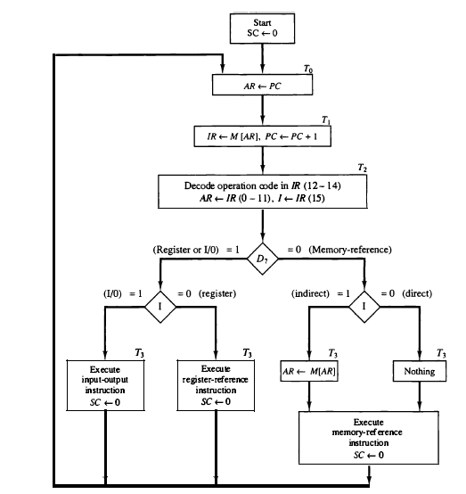
Flow Chart For Instruction Cycle

Slide 59
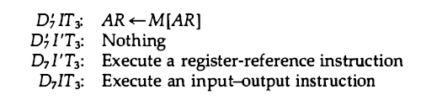

Slide 60
Definition of Register Reference Instructions
Register Reference Instructions are those which refer registers instead of some memory address or memory location for data to operate on

Slide 61
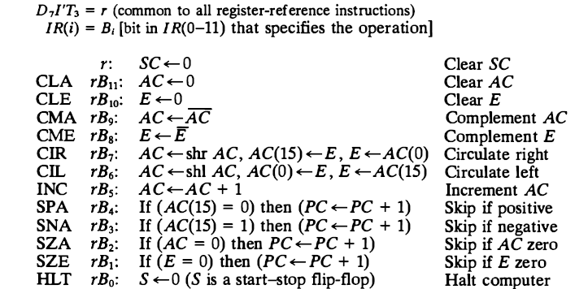
Register reference instructions
Reference: Morris mano

Slide 62
There are a total 12 register reference instructions in computer architecture that are in use and they are 1. CLA, 2. CMA, 3. CIL, 4. CIR, 5. INC, 6. SPA, 7. SNA, 8. SZA, 9. CLE, 10. CME, 11. SZE, 12. HLT
Each instruction has its own functionality and all these register reference instructions operate on accumulator only

Slide 63
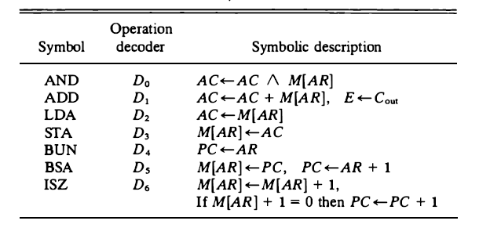
Memory reference instructions
There are seven different memory-reference instructions.

Slide 64

AND to AC
This is an instruction that performs the AND logic operation on pairs of bits in AC and the memory word specified by the effective address. The result of the operation is transferred to AC . The microoperations that execute this instruction are:

Slide 65
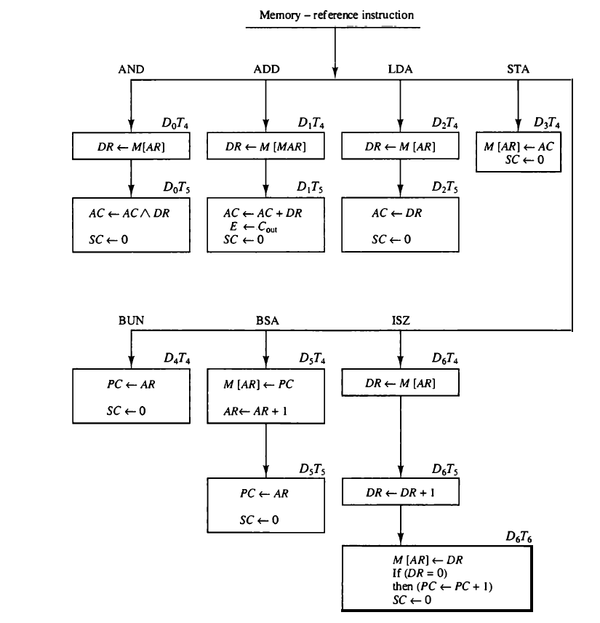
Flow chart for memory reference instructions

Slide 66
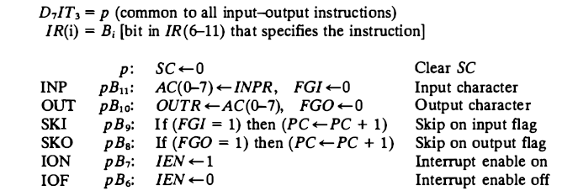
Input and output instructions

Slide 67
Addressing modes
The operation field of an instruction specifies the operation to be performed.
This operation must be executed on some data stored in computer registers or memory words.
The way the operands are chosen during program execution is dependent on the addressing mode of the instruction.

Slide 68
Types of addressing modes
Implied Mode
Immediate Mode
Register Mode
Register Indirect Mode
Autoincrement or Autodecrement Mode
Direct Address Mode
Indirect Address Mode
Relative Address Mode
Indexed Addressing Mode
Base Register Addressing Mode

Slide 69
Implied addressing mode
In this mode the operands are specified implicitly in the definition of the instruction.
Example: CMA,CLA,CLE
all register reference instructions that use an accumulator are implied-mode instructions.

Slide 70
Immediate Mode
In this mode the operand is specified in the instruction itself. In other words, an immediate-mode instruction has an operand field rather than an address field.
Immediate- mode instructions are useful for initializing registers to a constant value.
Eg: ADD A,1234H
A=2222H
AFTER EXECUTION A=3456H

Slide 71
Register Mode
In this mode the operands are in registers that reside within the CPU. The particular register is selected from a register field in the instruction.
Eg: Add A,DR

Slide 72
Register Indirect Mode
In this mode the instruction specifies a register in the CPU whose contents give the address of the operand in memory. In other words, the selected register contains the address of the operand rather than the operand itself.
The advantage of a register indirect mode instruction is that the address field of the instruction uses fewer bits to select a register than would have been required to specify a memory address directly.
Eg: ADD A,[AR]
AR=5000H
5000H=1234H
ADD A,[5000H]

Slide 73
Autoincrement or Autodecrement Mode
This is similar to the register indirect mode except that the register is incremented or decremented after (or before) its value is used to access memory.
MOV A,[AR]
INC AR
LOOP

Slide 74
Direct Address Mode
In this mode the effective address is equal to the address part of the instruction. The operand resides in memory and its address is given directly by the address field of the instruction.
In a branch-type instruction the address field specifies the actual branch address.
Eg: ADD A ,[5000H]
Eg : BUN 2000H

Slide 75
Indirect Address Mode:
In this mode the address field of the instruction gives the address where the effective address is stored in memory. Control fetches the instruction from memory and uses its address part to access memory again to read the effective address.

Slide 76
Relative Address Mode
In this mode the content of the program counter is added to the address part of the instruction in order to obtain the effective address.
The address part of the instruction is usually a signed number (in 2' s complement representation) which can be either positive or negative.
When this number is added to the content of the program counter, the result produces an effective address whose position in memory is relative to the address of the next instruction.

Slide 77
Indexed Addressing Mode
In this mode the content of an index register is added to the address part of the instruction to obtain the effective address.
The index register is a special CPU register that contains an index value.
The address field of the instruction defines the beginning address of a data array in memory.

Slide 78
Base Register Addressing Mode
In this mode the content of a base register is added to the address part of the instruction to obtain the effective address.
This is similar to the indexed addressing mode except that the register is now called a base register instead of an index register.
An index register is assumed to hold an index number that is relative to the address part of the instruction.
A base register is assumed to hold a base address and the address field of the instruction gives a displacement relative to this base address.

Slide 79
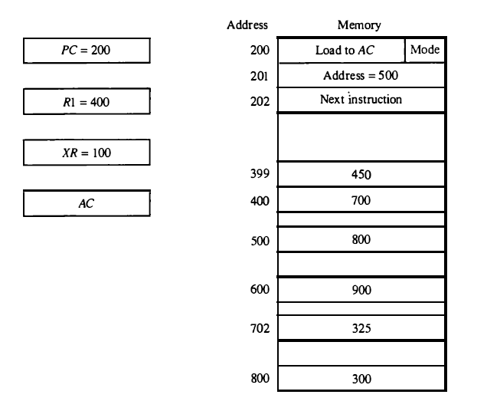
Numeric example for Addressing modes

Slide 80
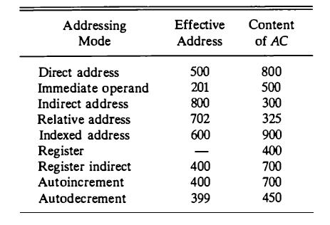

Slide 81
INSTRUCTION SET
computer instructions can be classified into three categories:
Data transfer instructions
Data manipulation instructions
Program control instructions

Slide 82
Data transfer instructions
Data transfer instructions cause transfer of data from one location to another without changing the binary information content.
Data manipulation instructions are those that perform arithmetic, logic, and shift operations.

Slide 83
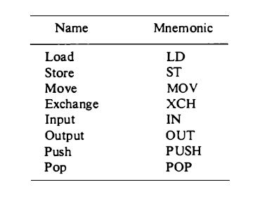
Data transfer instructions
Mov AC,R1

Slide 84
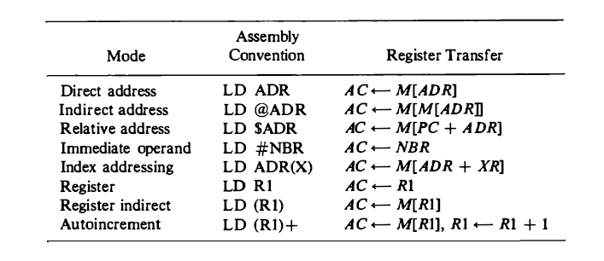
ADDRESSING MODES FOR LOAD INSTRUCTION

Slide 85
Data Manipulation Instructions
Data manipulation instructions perform operations on data and provide the computational capabilities for the computer.
The data manipulation instructions in a typical computer are usually divided into three basic types:
Arithmetic instructions
Logical and bit manipulation instructions
Shift instructions

Slide 86
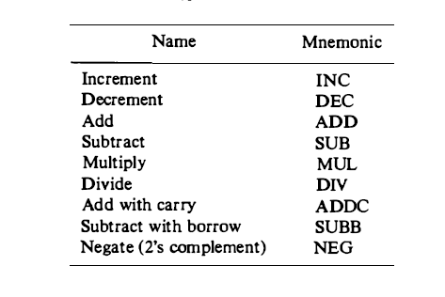
Arithmetic Instructions

Slide 87
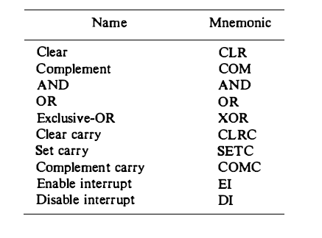
Logical and Bit Manipulation Instructions

Slide 88
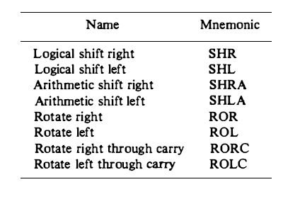
SHIFT INSTRUCTIONS

Slide 89
Program Control
Program control instructions provide decision-making capabilities and change the path taken by the program when executed in the computer.
The instruction set of a particular computer determines the register transfer operations and control decisions that are available to the user.

Slide 90
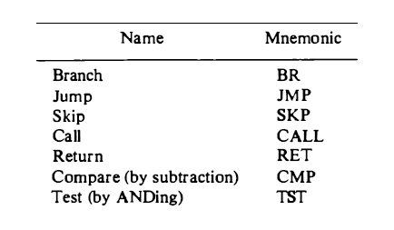
Program Control

